Slide 1
Evans Middle School’s
Get ready to VOTE!

Slide 2
Here are our sweet sixteen books!
From the Prairie’s Conference:

Slide 3
From the North Plains Conference!

Slide 4
GET READY FOR THE GAMES!
You will vote every two weeks, beginning April 15th. The winners of the first weeks’ games will advance to the Elite 8.
The week of April 29th, you will vote and the winners advance to the Final 4.
The finals will begin May 13th.
Who will win?

Slide 5
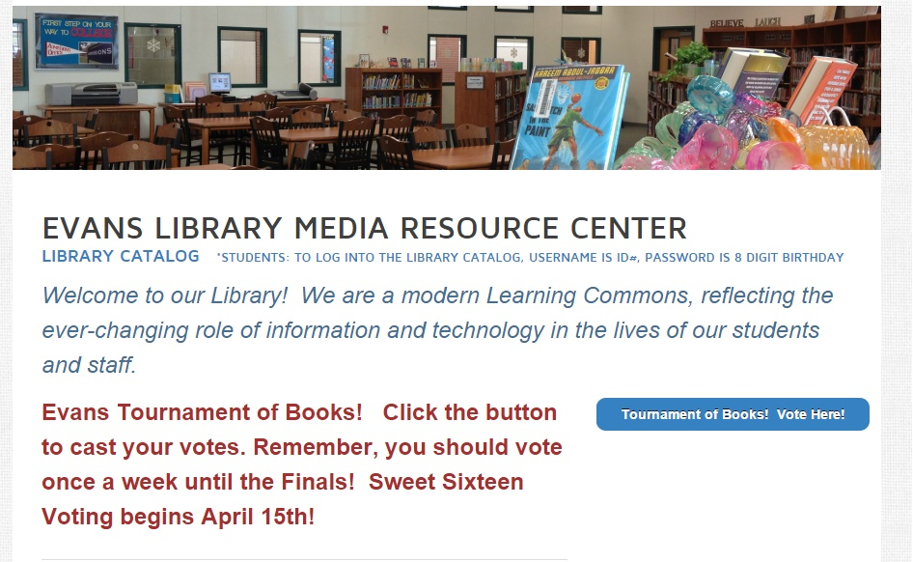
How do I vote?
Go to EMS Library Website
Click on Tournament of Books Button

Slide 6
You will log in with your MISD Gmail account
What is my MISD Gmail Username and Password?
Go to google.com-Click Sign In Firstname.LastnameXXX@student.mckinneyisd.net
Password: 8 digit birthday
The XXX stands for the last three digits of your ID number.
The first time you will need to click Agree
Then use the Google form and vote for your favorites!

Slide 7
We will update our board every two weeks
Which books will make the Elite 8?

Slide 8
Remember, The Evans Library Website!
www.evanslibrary.weebly.com
We have book trailers for all of the books!
We have the books to check out!
We have the voting form

Slide 9
Let the Games Begin!

